Slide 1

Project 3: FIFA World Cup Analysis
By: Piyush Kumar

Slide 2
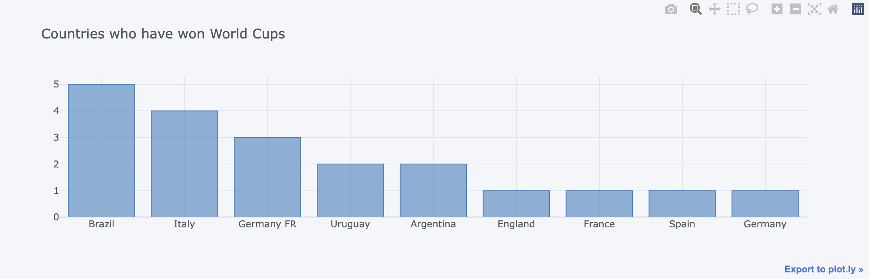
Countries with the most World Cups

Slide 3
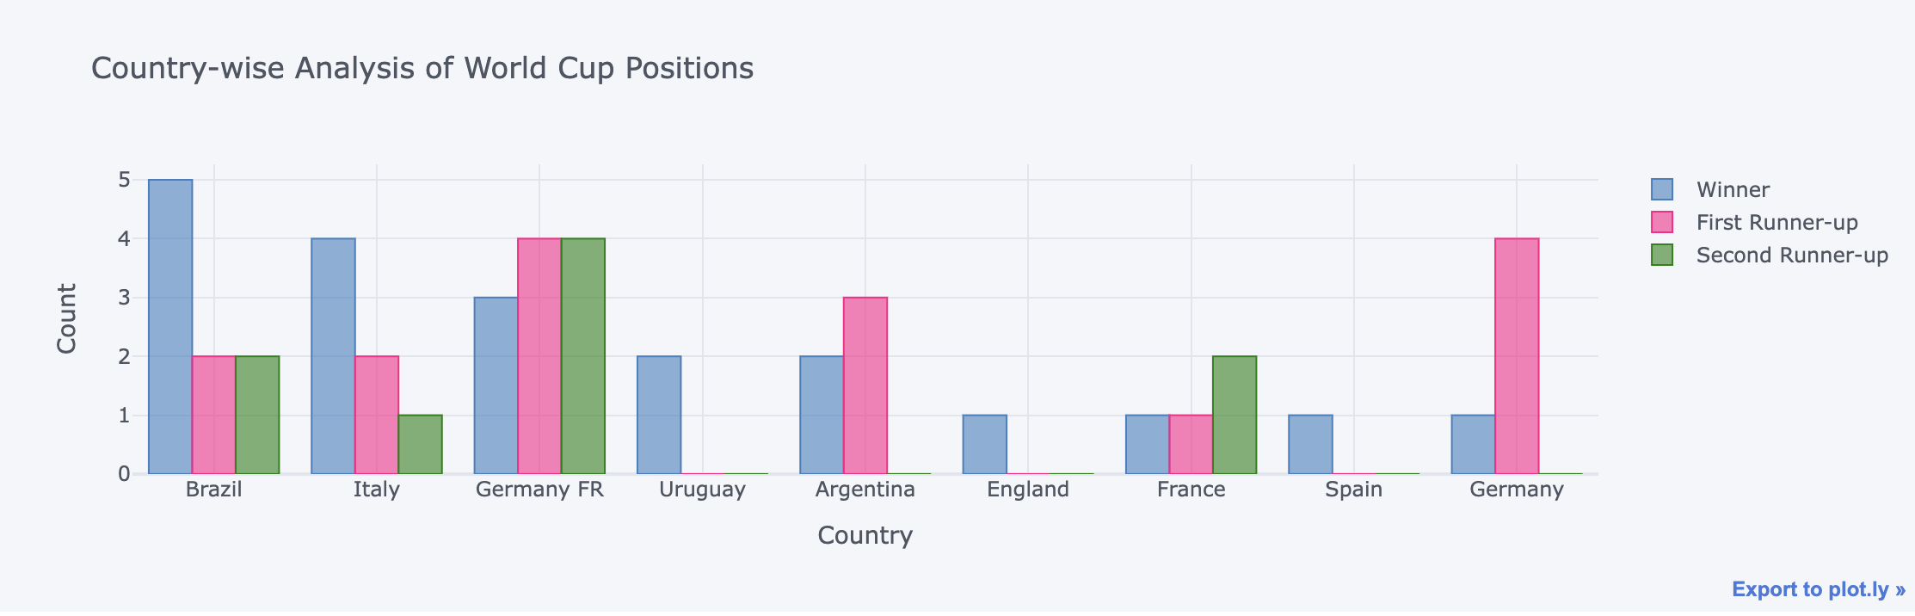
Country-wise Analysis of World Cup Positions

Slide 4
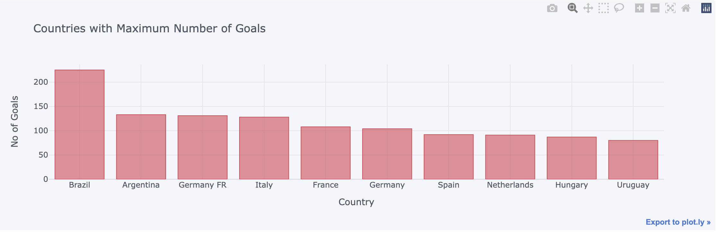
Countries with Maximum Number of Goals

Slide 5
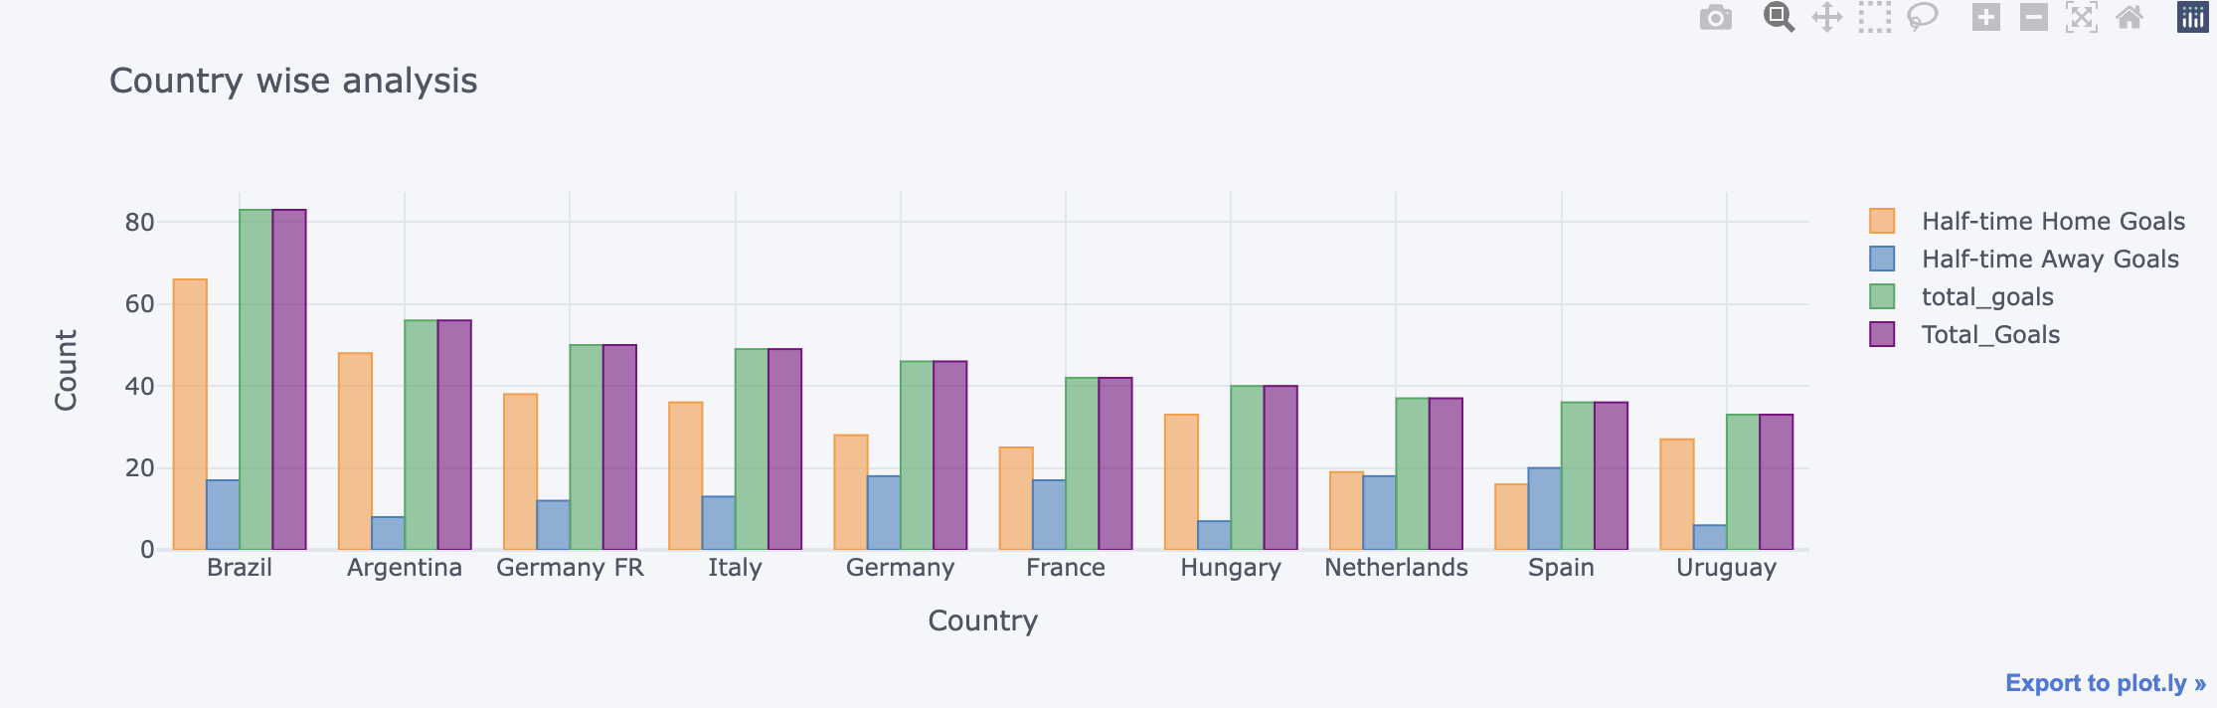
Country wise analysis

Slide 6
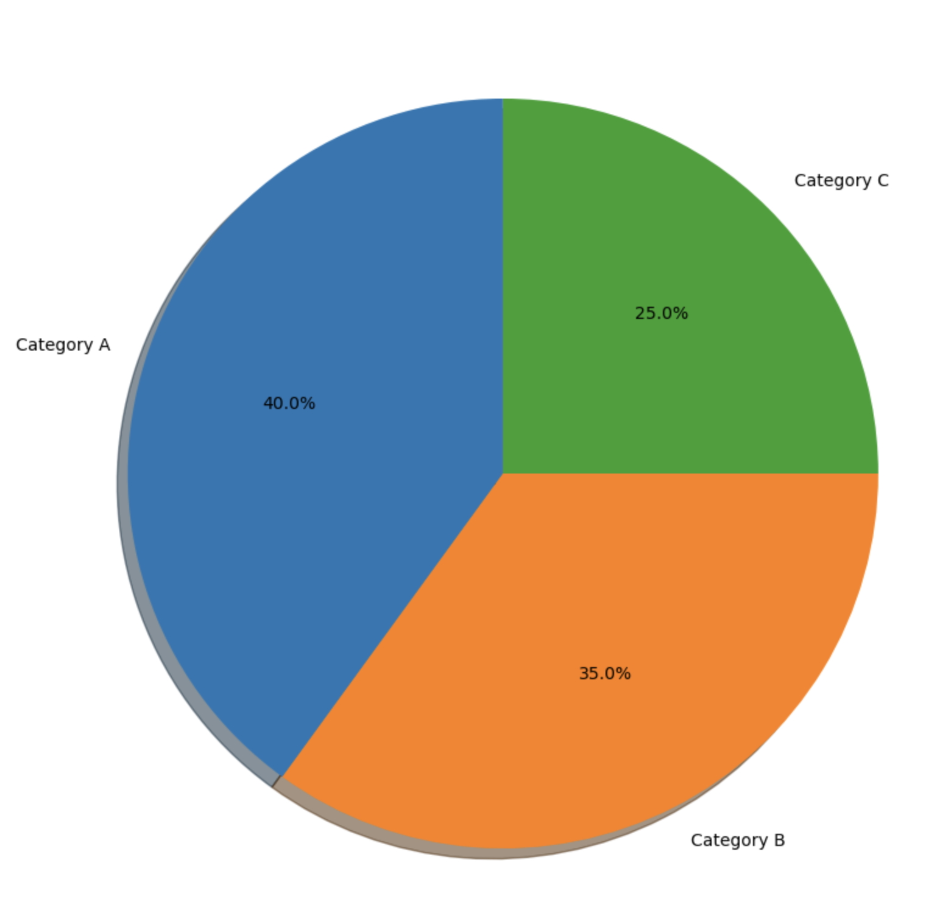
Category Wise Analysis

Slide 7
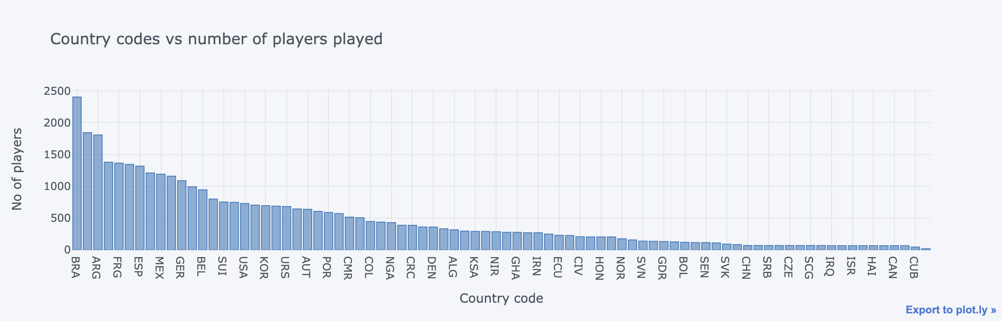
Country Codes vs Number of Players Played

Slide 8
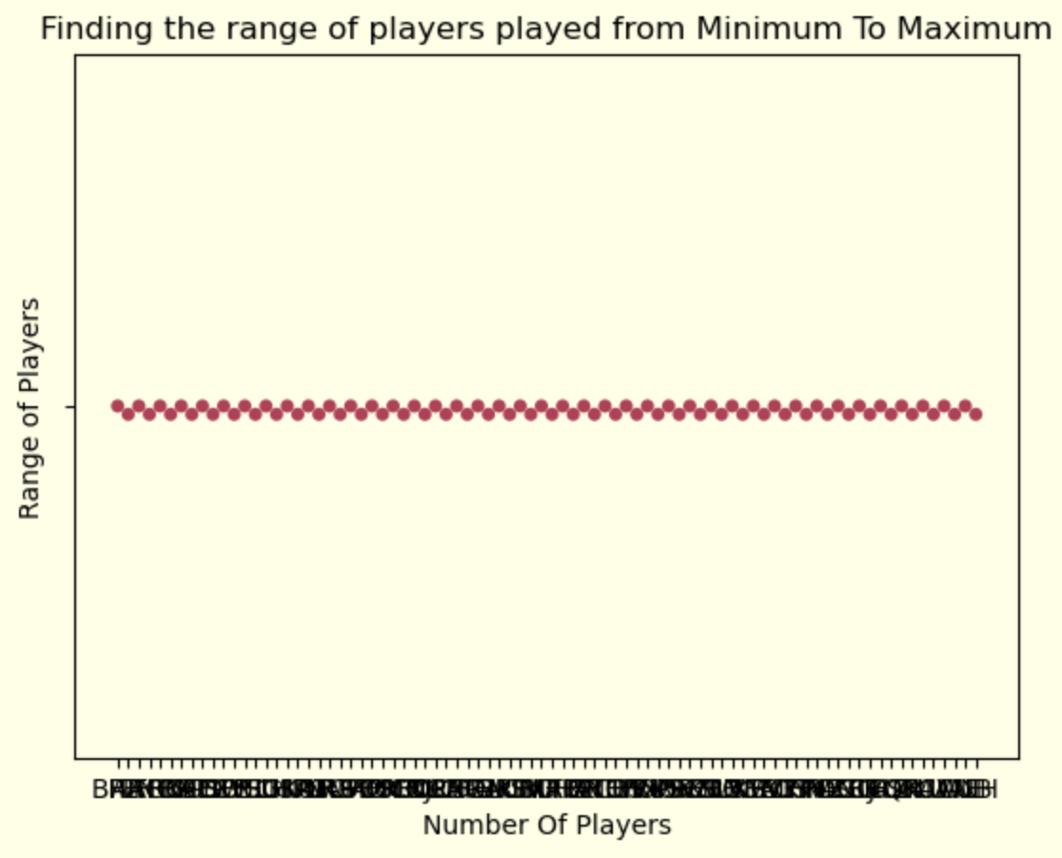
Range of Players Played from Minimum To Maximum

